Slide 1

Model Training and Evaluation

Slide 2
Intro to Machine Learning

Slide 3
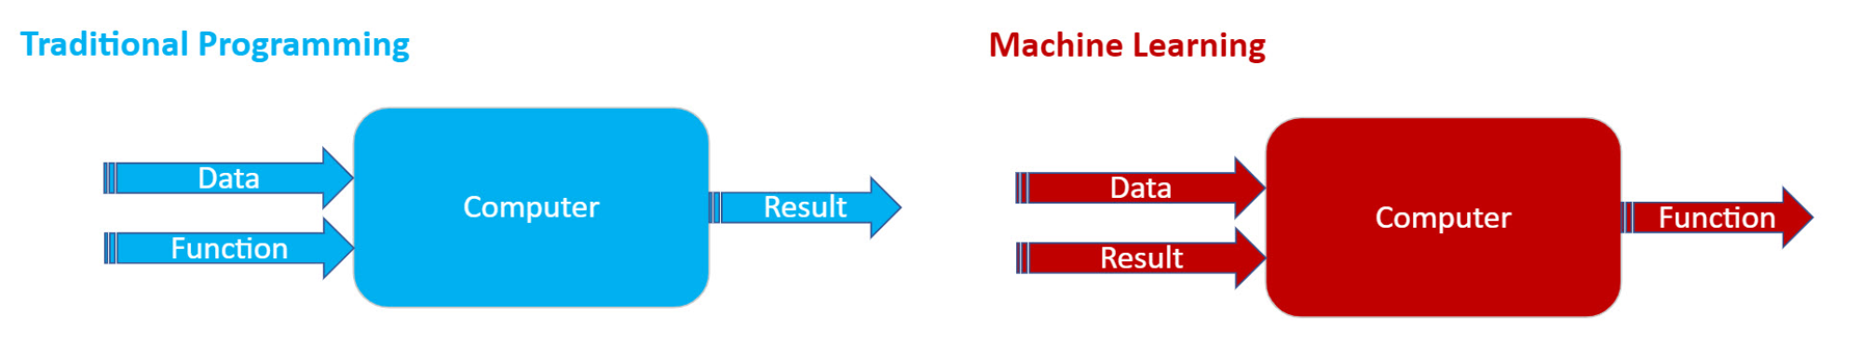
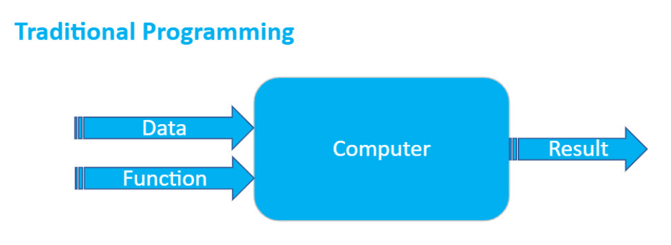
Introduction to Machine Learning
What does machine learn?

Slide 4
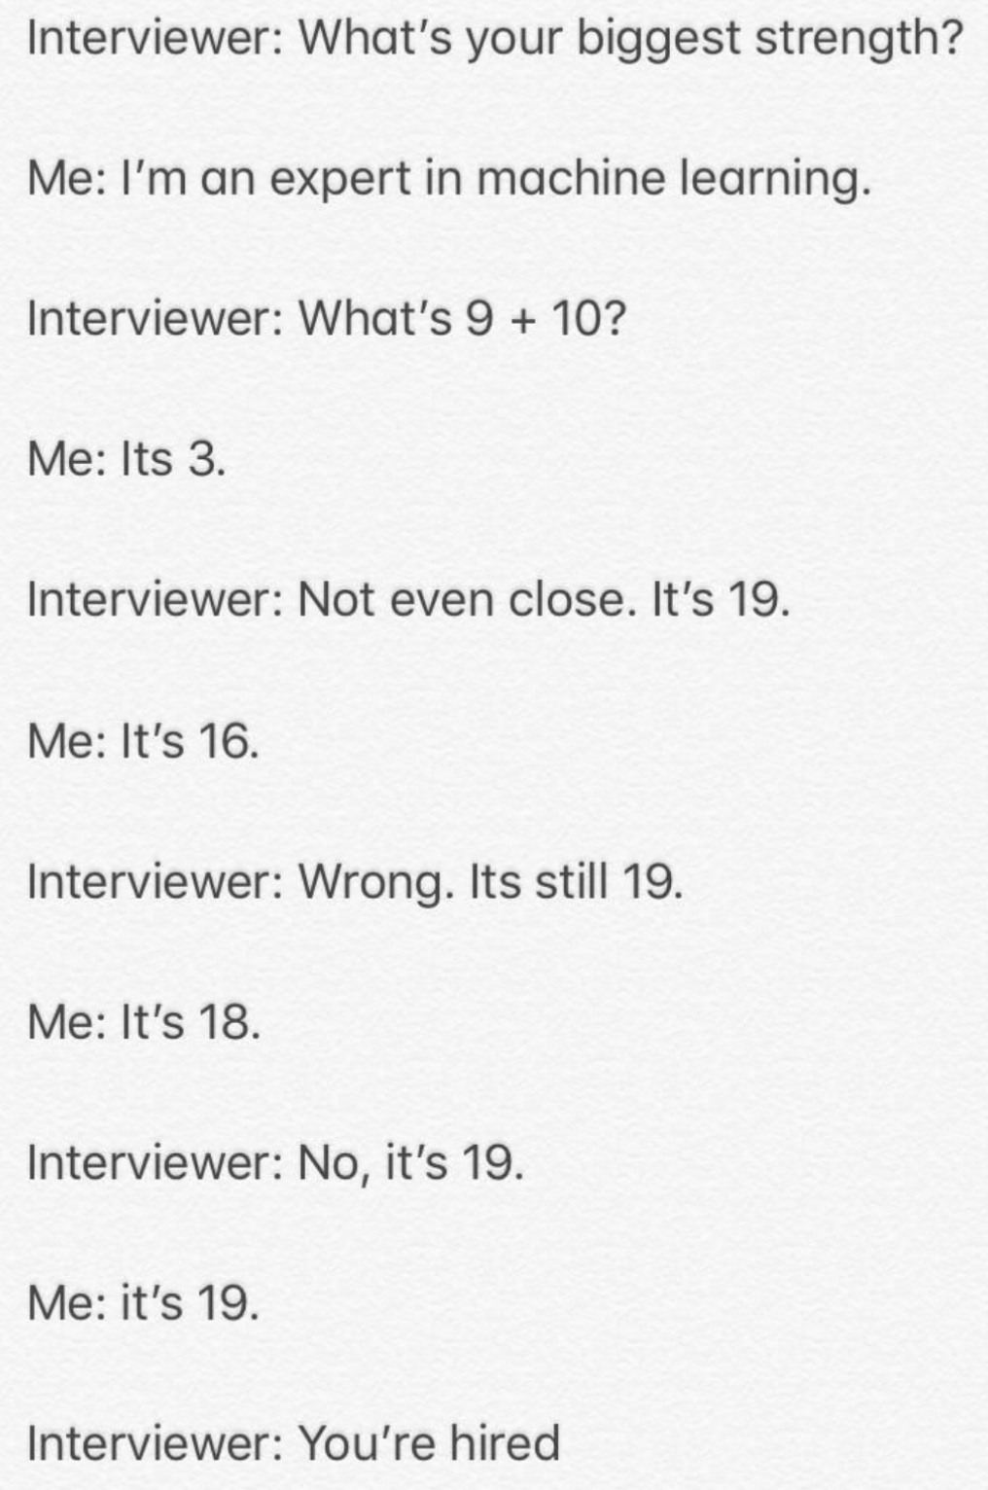
Introduction to Machine Learning
How does machine learn?

Slide 5
Machine Learning Training Types
Supervised training
Unsupervised training
Semi-supervise training

Slide 6
Machine Learning Problems
Some sub-categories of machine learning problems
Types | Description | Example
Regression | Predict numerical values | Salary, temperature
Classification | Pick one of n classes | Cat, dog, horse, or bear
Cluster | Group similar examples | Group similar books (unsupervised)
Reinforce Learning | Learn to make a series of decisions to achieve a goal | Chess

Slide 7
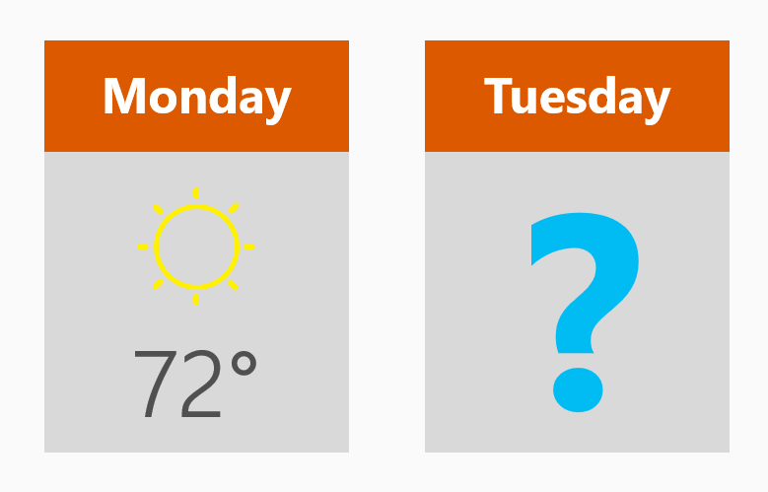
Regression Algorithms
How much? How many?
Regression algorithms make numerical predictions, such as:
What will the temperature be next Tuesday?
What will my fourth quarter sales be?
Answering any question that asks
for a number

Slide 8
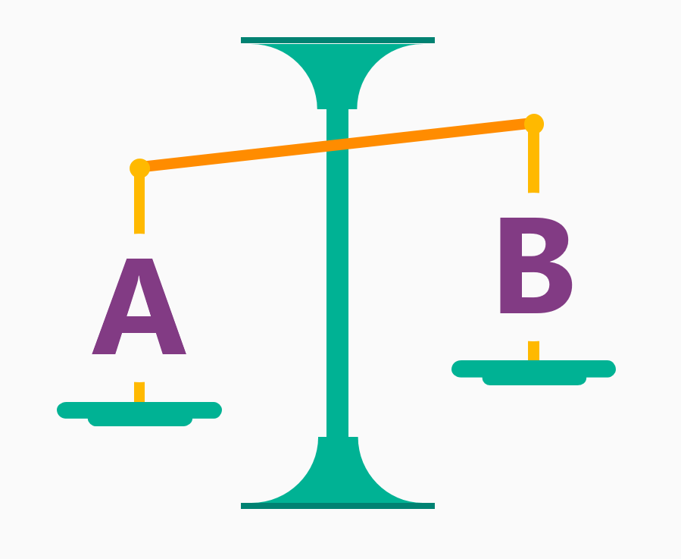
Classification Algorithms
Is it A or B?
Two-class classification algorithm
Useful for any question that has just two possible answers.
For example:
Will this tire fail in the next 1,000 miles: Yes or no?
Which brings in more customers: a $5 or a 25% off coupon?

Slide 9
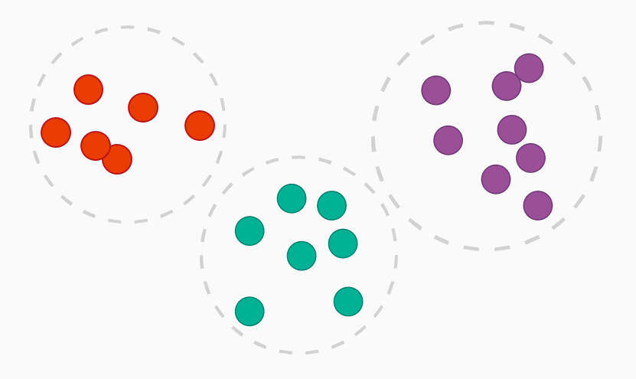
Clustering Algorithms
How is this organized?
Common examples of clustering questions are:
Which viewers like the same types of movies?
Which printer models fail the same way?
By understanding how data is organized, you can better understand - and predict – behaviors and events

Slide 10
Machine Learning Training Process
Data Collection
Feature Engineering
Training / Test split
Training
Evaluation

Slide 11
Training

Slide 12
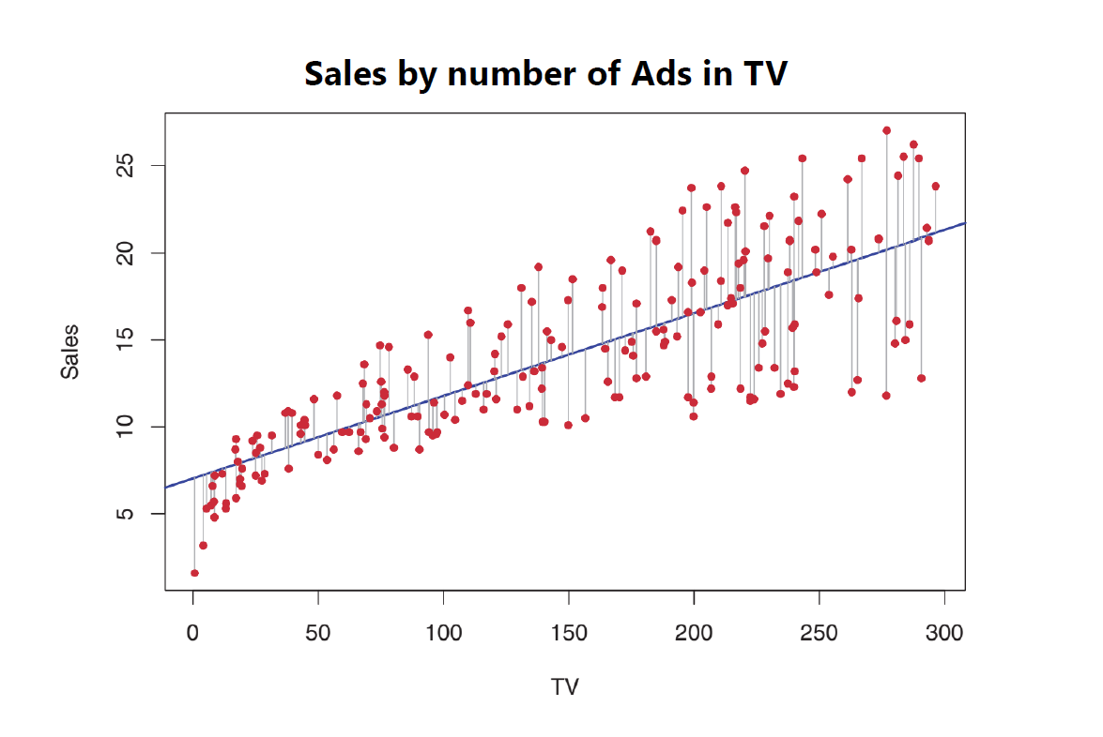
Regression

Slide 13
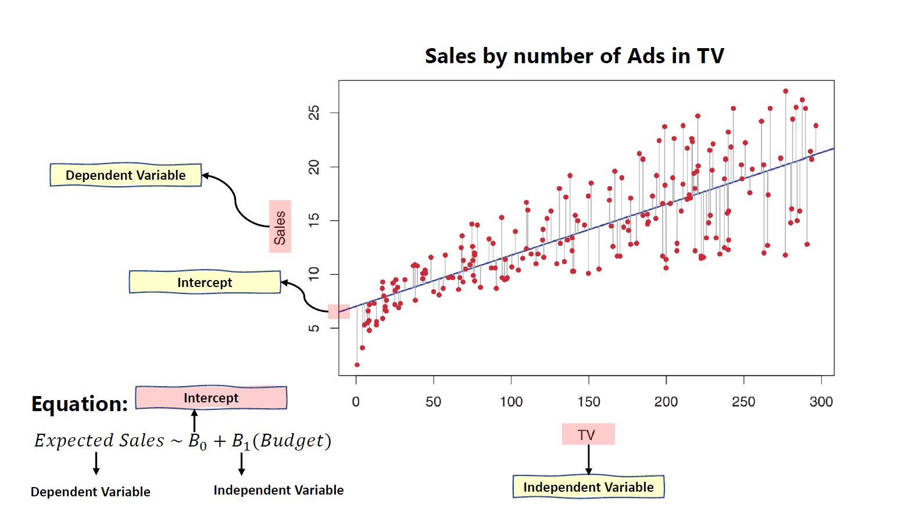
Regression

Slide 14
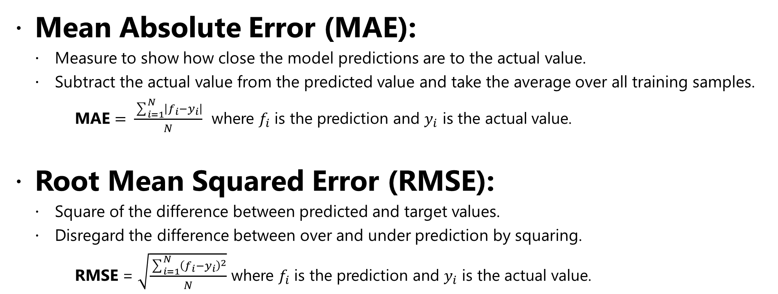
Metrics for Regression Model Performance
Mean Absolute Error (MAE):
Measure to show how close the model predictions are to the actual value.
Subtract the actual value from the predicted value and take the average over all training samples.
MAE $= \frac{\sum_{i=1}^{N}{\left|f_{i}−y_{i}\right|}}{N}$ where $f_{i}$ is the prediction and $y_{i}$ is the actual value.
Root Mean Squared Error (RMSE):
Square of the difference between predicted and target values.
Disregard the difference between over and under prediction by squaring.
RMSE = $\sqrt{\frac{\sum_{i=1}^{N}{{\left(f_{i}−y_{i}\right)}^{2}}}{N}}$ where $f_{i}$ is the prediction and $y_{i}$ is the actual value.
Notes:
https://docs.microsoft.com/en-us/azure/machine-learning/studio-module-reference/evaluate-model#bkmk_regression
The metrics returned for regression models are generally designed to estimate the amount of error. A model is considered to fit the data well if the difference between observed and predicted values is small. However, looking at the pattern of the residuals (the difference between any one predicted point and its corresponding actual value) can tell you a lot about potential bias in the model.
The following metrics are reported for evaluating regression models. When you compare models, they are ranked by the metric you select for evaluation.
Mean absolute error (MAE) measures how close the predictions are to the actual outcomes; thus, a lower score is better.
Root mean squared error (RMSE) creates a single value that summarizes the error in the model. By squaring the difference, the metric disregards the difference between over-prediction and under-prediction.

Slide 15
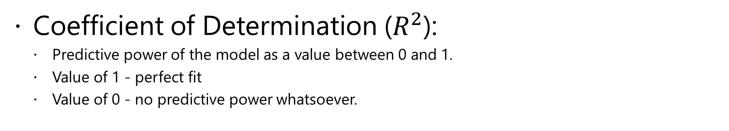
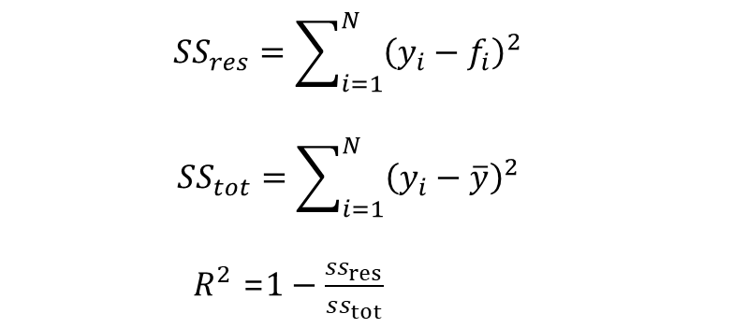
Metrics for Regression Model… (continued)
Coefficient of Determination ($R^{2}$):
Predictive power of the model as a value between 0 and 1.
Value of 1 - perfect fit
Value of 0 - no predictive power whatsoever.
$${SS}_{res}=\sum_{i=1}^{N}{{\left(y_{i}−f_{i}\right)}^{2}}$$
$$SS_{tot}=\sum_{i=1}^{N}{{\left(y_{i}−\overline{y}\right)}^{2}}$$
$R^{2}$ =$1−\frac{ss_{res}}{ss_{tot}}$
Notes:
https://docs.microsoft.com/en-us/azure/machine-learning/studio-module-reference/evaluate-model#bkmk_regression
Coefficient of determination, often referred to as R², represents the predictive power of the model as a value between 0 and 1. Zero means the model is random (explains nothing); 1 means there is a perfect fit. However, caution should be used in interpreting R² values, as low values can be entirely normal and high values can be suspect.

Slide 16
Regression Algorithms
Common Regression Algorithms
Linear Regression
Decision Tree / Random Forest Regressor
Support Vector Regression
Neural Network

Slide 17
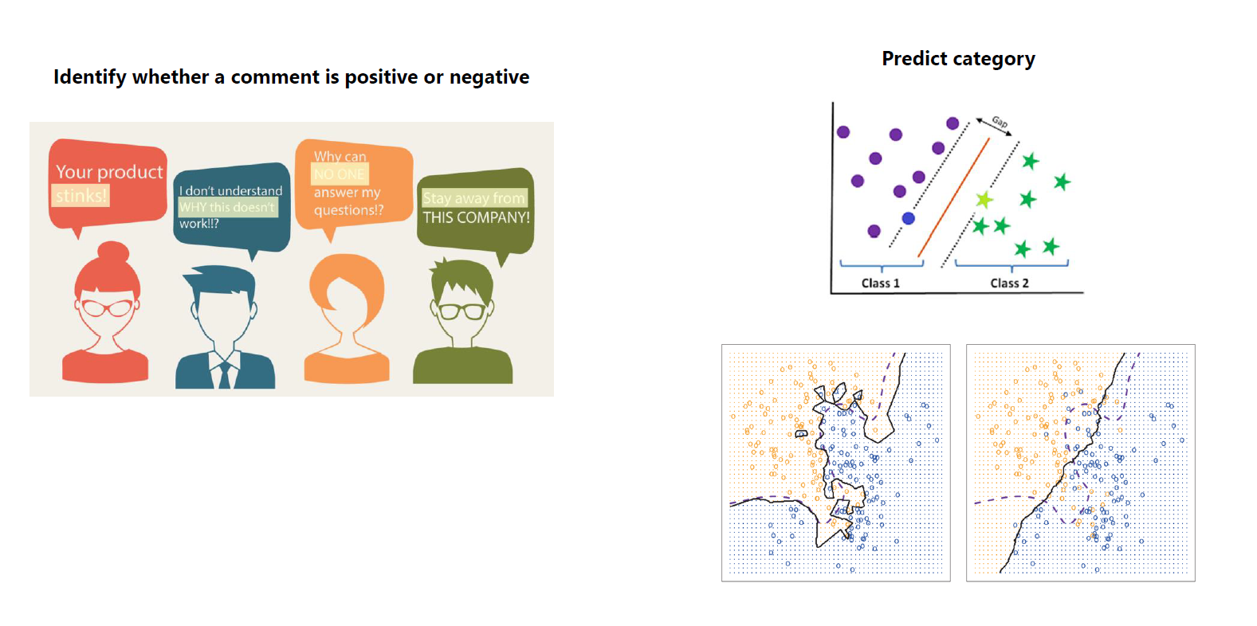
Classification

Slide 18
Classification Algorithms
Common Classification Algorithms
Logistic Regression
Decision Tree / Random Forest Classifier
k-Nearest Neighbors
Naive Bayes
Support Vector Machine
Neural Network

Slide 19
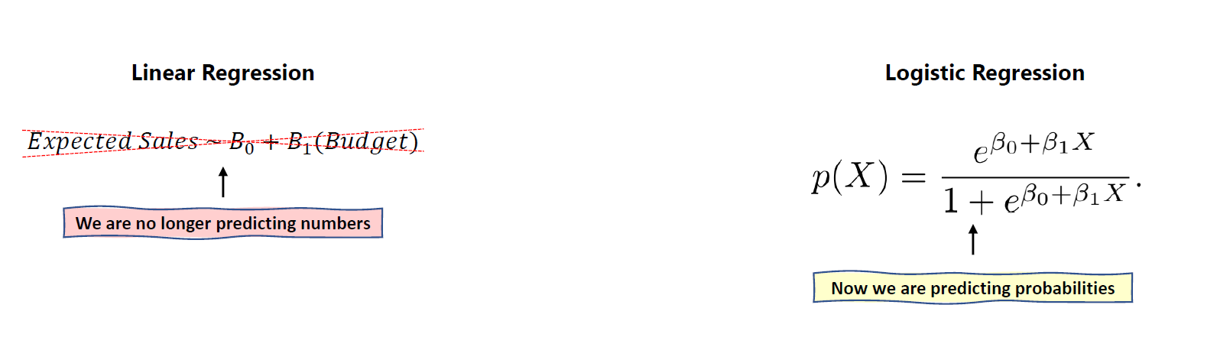
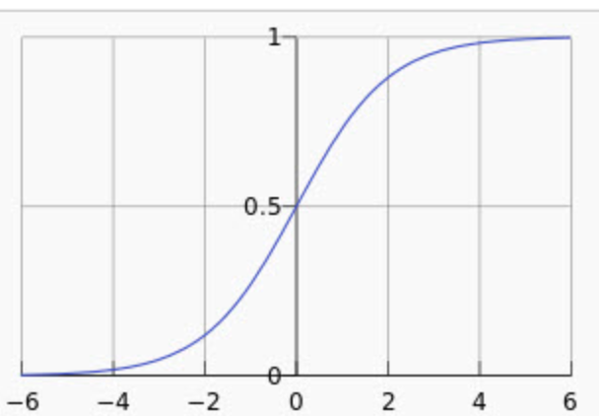
Classification – Logistic Regression

Slide 20
Classification - More
Support Vector Machines
Supervised learning method used in classification and regression.
Training data consists of examples labeled as belonging to one of two categories.
Creates a model that assigns a new example to one category or the other.
Decision Trees:
Tree-like model of decisions and their possible consequences.
Each node in the tree represents a feature.
Each branch coming from a node represents a decision made based on the value of the feature.
Each leaf represents the outcome of the related decision.

Slide 21
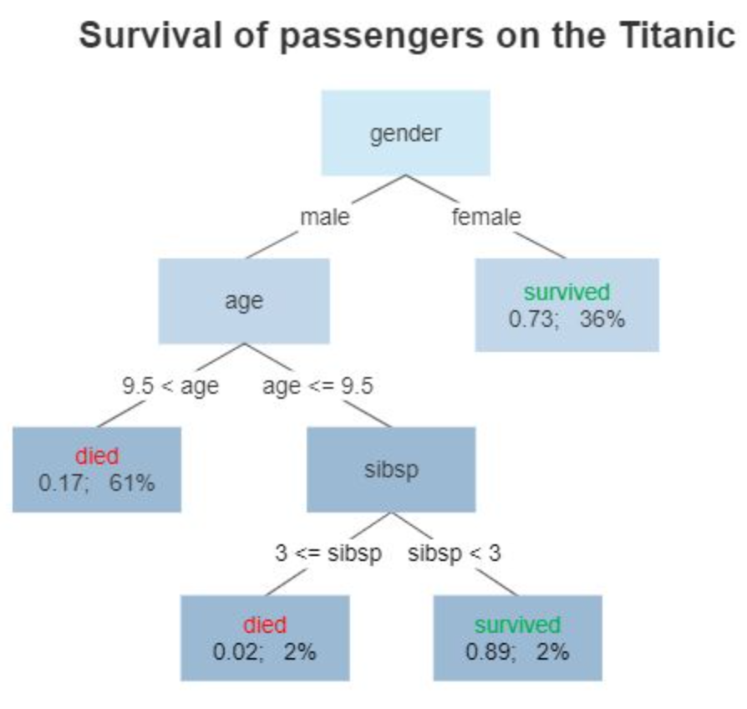
Classification – Decision Tree
A tree showing survival of passengers on the Titanic ("sibsp" is the number of spouses or siblings aboard). The figures under the leaves show the probability of survival and the percentage of observations in the leaf. Summarizing: Your chances of survival were good if you were (i) a female or (ii) a male younger than 9.5 years with strictly less than 3 siblings.

Slide 22
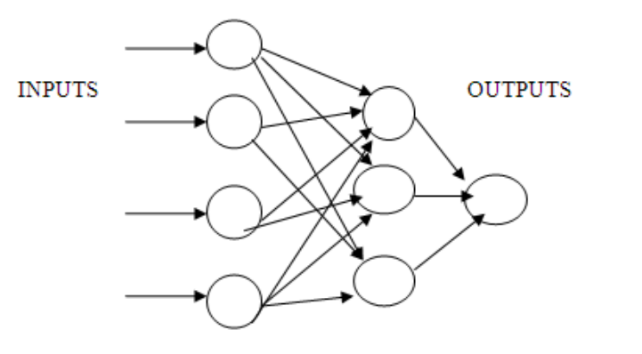
Classification – Neural Network

Slide 23
Classification Model Performance
Binary classification has two classes:
Positive or 1: Model predicts a certain email to be a spam.
Negative or 0: Model predicts the email is NOT a spam.
Two possibilities for each prediction:
True: Model predicted correctly
Model predicted a certain email to be spam, while the email WAS actually spam.
Model predicted a certain email was not spam, and it actually was NOT spam.
False: Model predicted incorrectly
Model predicted an email to be spam, while it was NOT spam.
Model predicted an email was not spam, while it WAS spam.

Slide 24
Classification Model Performance (continued)
Four possible combinations of classification and prediction:
True Positive (TP)
Classify an email as spam, while it WAS spam.
True Negative (TN)
Classify an email as not spam, while it was NOT spam.
False Positive (FP)
Classify an email as spam, while it WAS NOT spam.
False Negative (FN)
Classify an email as not spam, while it WAS spam.
Notes:
When creating a model, some of the data is used for training and the rest is used for validation. Through the validation process, we can find the counts of TP, TN, FP, FN of the model.
Number of data points that fall into the four categories (TP, TN, FP, FN) based on predictions made by a classifier are used to derive classification performance metrics.

Slide 25
Classification Performance Metrics
Confusion Matrix
Counts of TP, TN, FP, FN are displayed in a Confusion Matrix.
Classification performance metrics are derived from elements of the confusion matrix.
Actual Positives
Actual Negatives
Predicted Positives
TP | FP
FN | TN
Predicted Negatives
Notes:
Confusion matrix can also be created for multi-class classifications. Binary classification provides a simpler way to explain the confusion matrix and classification performance metrics.
In an ideal case, FN = 0 and FP = 0. In real life that is not possible. Errors will result in FP and FN. We try to reduce FP and FN to improve classification model performance.
Whether we should focus on reducing FP or FN depends on the case and business requirements.
Suppose that we are working on a cancer detection model. In such a case we should try to reduce False Negatives (FN). If a non-cancerous patient is incorrectly classified as
having cancer (False Positive), s/he will go for additional tests. BUT if a patient that has cancer is classified as non-cancerous (False Negative), they will not go for another test
and their condition will remain untreated. This is an example of a case where reducing FN is more important than reducing FP.
Now suppose that we have created a model that classifies emails as spam or not spam. In this case, we may want to focus on reducing False Positives. If someone has sent job applications
and is expecting emails from potential employers, they wouldn’t want those emails to be incorrectly classified as spam. So in this case, we focus on reducing FP.

Slide 26
Classification Performance Metrics (continued)
Accuracy
Percentage of correct predictions.
(TP + TN) /(TP + TN + FP + FN).
Use when the imbalance between the two classes is not large.
TP | FP
FN | TN
Notes:
Accuracy is the total number of correct predictions (TP + TN) divided by the total number of predictions. Multiply by 100 to get a percentage.
Explained differently, accuracy is a measure of how often the model makes a correct prediction.
Accuracy is not a good performance measure if a large majority of target variables belong to one class.
Suppose that our model detects cancer, and that we have a sample size of 100 people, out of which 7 people actually have cancer. If during validation
our model classifies all participants as cancer-free, then TP = 0, TN = 93, and accuracy of our model will be 93%. Considering the fact that our model
has missed ALL of the positive cases, can we say that it is a good model due to its high accuracy?

Slide 27
Classification Performance Metrics (continued)
Precision and Recall
Precision: Percentage of positive predictions that were correct.
TP/(TP + FP)
Recall/Sensitivity: Percentage of actual positives that were predicted correctly.
TP/(TP + FN)
TP | FP
FN | TN
TP | FP
FN | TN
Notes:
Precision shows the percentage of positive classifications that were correct. It is the number of True Positives (TP) divided by the total number of positive classifications (TP + FP).
The total number of positive predictions TP+FP. The number of correct positive predictions is TP. Hence, (TP / TP+FP) * 100 is the percentage of positive predictions that were correct.
Suppose in a model that is supposed to detect cancer, we have a sample of 100 people, of which 10 people actually have cancer. If our model misses the prediction on all cancer-free
patients and predicts all 100 participants as having cancer, then TP = 10, and FP = 90. In this case the precision of the model would be (10/10+90)=0.1 or 10%.
Recall shows the percentage of actual positives that were predicted correctly. The number of actual positive classifications is TP+FN. The number of correct positive predictions is TP.
Suppose in the cancer detection model with a sample size of 100 where 10 participants actually have cancer, the model predicts that all 100 participants have cancer. In this case,
the number of negative predictions is zero. This means FN = 0 and TP = 10. So the Recall of the model is (10 / 10 + 0) * 100 = 100%. Precision is not about catching all positive cases.
The number of False Negatives plays no role in determining Precision.
Precision and Recall can be compared.
Precision is a measure of how precise or accurate the model is, by finding out of those cases that were predicted as positive how many of them were actually positive. Of all of the
cases that our model predicted as having cancer, how many of them were correct. So even if we the model predicts that only one of the cases has cancer and that prediction is correct, then
TP = 1 and FP = 0, which means Precision of the model is 100%.
Recall is more about catching ALL positive cases correctly. So if the model catches more cases that are actually positive, then we would expect Recall to be high. Suppose in the cancer detection
model, with a sample size of 100 where 10 participants actually have cancer, our algorithm predicts that all 100 individuals have cancer. In this case TP = 10 and FN = 0. This results in
the Recall to be (10 / 10 + 0) * 100 = 100%.

Slide 28
Classification Performance Metrics (continued)
Precision = TP/(TP + FP).
Lower FP → Higher Precision.
Recall/Sensitivity = TP/(TP + FN).
Lower FN → Higher Recall.
Choice of metric depends on the case.
FN more costly in disease detection → Use Recall.
FP more costly in detecting spam emails → Use Precision.
Notes:
If business needs and requirements determine that reducing False Negatives is more important, then use Recall. If reducing False Positives is more important, then use Precision.
For algorithms that deal with cases like spam detection, high number of False Positives can be more costly (classifying an email containing a job offer as spam). So for these cases use Precision, and reduce FP
to increase Precision.
For algorithms that deal with detecting disease or fraudulent transactions, high number of False Negatives is very costly/dangerous. So for these cases, use Recall as the metric and try to reduce FN
so that Recall is high.

Slide 29
Classification Performance Metrics (continued)
F1 Score
Harmonic mean of Precision and Recall.
2 * (Precision * Recall) / (Precision + Recall).
Use F1 Score when:
you need a balance between Precision and Recall,
and
variables are distributed unevenly between two classes.
Notes:
Arithmetic mean of two numbers is tilted toward the larger number, while the harmonic mean tilts toward the smaller number.
F1 score can bethought of as the weighted average between Precision and Recall. It is a number between 0 and 1, with 0 as its worst value and 1 as its ideal value.
F1 score is used when you want to improve your model such that there is a balance between Precision and Recall. If there is a big difference between the two,
then the F1 score is closer to 0. If the difference between Precision and Recall is small (the two are balanced), then the F1 score is closer to 1.

Slide 30
Classification Performance Metrics (continued)
AUC/AUROC
Area Under ROC Curve.
ROC curve plots True Positive Rate (TPR) vs False Positive Rate (FPR).
TPR = TP / (Actual/Total number of positives).
FPR = FP / (Actual/Total number of negatives).
Notes:
ROC: Receiver Operating Characteristic. ROC curves were used in WWII to evaluate the ability of radar receiver operators in differentiating between signal and noise.
ROC curves now have applications in machine learning, statistics and other areas. ROC curves can be used to measure performance of binary and multi-class classifiers.
ROC curve plots TPR (y axis) against FPR (x axis). TPR and FPR are rates, so they are both in the range [0,1].
Actual or total number of positives = TP + FN
Actual or total number of negatives = TN + FP
AUC: Area Under the Curve, in this case Area Under the ROC Curve.

Slide 31
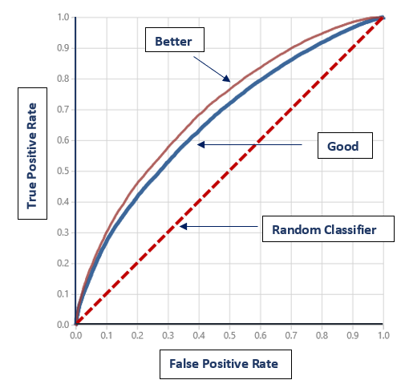
Classification Performance Metrics (continued)
Performance metric is the area under the ROC curve.
Random guessing results in AUC = 0.5.
Classifier AUC should be greater than 0.5.
Higher AUC indicates better performance.
Notes:
If a model guesses randomly (worst case), it means that the probability that each data point is classified as positive or negative is 1/2.
As a result, ROC curve of a classifier that guesses randomly is a straight line.
Curves with higher AUC indicate better performance.

Slide 32
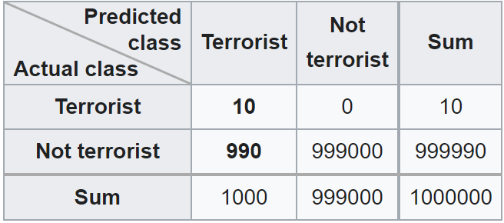
Accuracy Paradox
A city of 1 million people has ten terrorists and below is a confusion matrix for a classifier:
Accuracy: 99.9%
Precision: 1%
Recall: ?
F1: ?
-- Wikipedia
Notes:
Recall 1
F1 ~2%
https://en.wikipedia.org/wiki/Accuracy_paradox

Slide 33
Imbalanced Dataset
Any dataset with an unequal class distribution is technically imbalanced. However, a dataset is said to be imbalanced when there is a significant, or in some cases extreme, disproportion among the number of examples of each class of the problem.
the learning process of most classification algorithms is often biased toward the majority class examples, so that minority ones are not well modeled into the final system.
-- Learning from Imbalanced Data Sets

Slide 34
Workaround
Collect more data
Choose another metric
Data sampling
Use Synthetic data
Use different algorithm
Compensate minor class(es)
-- Learning from Imbalanced Data Sets

Slide 35
Challenge Preparation Activities
ML For Beginners - 4 - Classification (~ 6-8 hours)
Understand Data Science for Machine Learning - Learning Path (7 hours 25 minutes) - If time permits, the entire learning path is ideal – but prioritize these three:
Train and evaluate classification models (47 minutes)
Confusion matrix and data imbalances (52 minutes)
Measure and optimize model performance with ROC and AUC (36 minutes)
Linkedin Learning Resources
Applied Machine Learning: Foundations (Linked Learning) (2 hours 38 minutes)
Applied Machine Learning: Algorithms (LinkedIn Learning) (2 hours 24 minutes)
Imbalanced Target Categories (3 minutes)
Treating Imbalanced Datasets (4 minutes)

Slide 36
Modeling - Leaderboard Challenge
Access the dataset here:
Instructions to complete:
Scoring methodology:

Slide 37
Additional Resources
For AML Specific Modeling:
Train a Model with Azure ML
Train & Evaluate Regression Models (Azure ML)
Train & Evaluate Classification Models (Azure ML)
Videos:
Introduction to AI/ML
Introduction to Classification

Slide 38
Demo

